Slide 1
Raspberry pi based Surveillance Robot for Real Time Intrusion Detection and Tracking
Aniruddh Bhagwat 405B005
Manav Chouhan 405B018
Rohit Kshirsagar 405B036
Prashant Kumar 405B049

Slide 2
Introduction
Robots can be used at a number of places, making our daily life easier. Raspberry-pi based robots are easy to implement, require minimum cost input and solve important problems.
We propose to build a raspberry-pi based robot for intrusion detection.

Slide 3
Problem Statement
Make a surveillance robot to ensure safety of the house, identify the intruder, track him and alert the owner.

Slide 4
Motivation
With increase in workforce of the country, the houses remain vacant when it’s members are out there in offices. Hence there is :
Need to ensure security of house.
Need of an assistant for house.
Need to alert owner if someone unwanted comes in.
We aim to build a surveillance robot that solves the above needs.

Slide 5
Objective
Once completed the robot will solve the following requirements:
Identify the person, when the person enters the premises.
Alert the owner, send an image of the person to the owner.
Identifies the person as known or unknown while following.
Take next set of instruction from owner and work accordingly.
Send the captured activity to the owner after getting reset command.
Return to its original position.

Slide 6
Idea Evaluation Matrix
Scoring 1 = Low 2 = Moderate 3 = High | Different or Better | Delivers Value | Doable, Practical | Potential for early adopters | Score
Person Identification, Communication & Tracking Robot | H | M | H | H | 11
Domestic Help Robot | M | H | L | M | 8
Home Automation Robot | L | H | M | H | 9

Slide 7
IDEA MATRICES
I Matrix
IDEA | Deliverables | Parameters Affected
Increase | It increases the security of the house. | Performance
Improve | The communication between user and robot | Integration between human and robot.
Ignore | Stops following if person is known. | Identification

Slide 8
IDEA MATRICES
D Matrix
IDEA | Deliverables | Parameters Affected
Deliver | Delivers efficient performance by following person. | Tracking and communication
Decrease | Decreases the concern of security of house. | Security
Drive | Facility to send videos, tracking. | Navigation, Identification

Slide 9
IDEA MATRICES
E Matrix
IDEA | Deliverables | Parameters Affected
Educate | Educate people regarding security | Project Users
Eliminate | Eliminates the risk of intrusion. | Security

Slide 10
IDEA MATRICES
A Matrix
IDEA | Deliverables | Parameters Affected
Accelerate | Accelerates the communication with user | Communication
Associate | Works with a processing unit to process data. | Processing
Avoid | Avoids latency in communication by using UDP protocol and telegram for communication. Avoids risk of intrusion. | Comunication and Security

Slide 11
Hardware Requirements
Raspberry Pi 3B
Ultrasonic Sensor Module HC-SR04
ROBOT Chassis
Wheels, DC Motors
Raspberry pi 5MP camera
Bread Board
Resistor (1k)
Motor Driver L298 2A
Connecting wires
Power supply or Power bank

Slide 12
Software Requirements
Python3 and necessary libraries.
Text Editor
Raspberry pi OS
VnC Server
Telegram app

Slide 13
Literature Survey
Title | Published Year | Basic Idea
Human Detection using HOG-SVM, Mixture of Gaussian and Background Contours Subtraction | 2017 | Human detection using HOG-SVM algorithms
Human Detection and Tracking for Video Surveillance: A Cognitive Science Approach | 2017 | Detect human beings in any frame.Find the movement patterns of the humans in the frame.
Obstacle Detection and Avoidance Robot | 2018 | Detect and avoid any obstacles in the path.Focuses on the edge detection for higher accuracy.
Design and Implementation of an Autonomous Indoor Surveillance Robot based on Raspberry Pi | 2019 | Identify the person and alert the owner. Take necessary actions through the commands given by the owner.

Slide 14
System Overview
The product is a robot which is being developed to ensure security of a house. It is a raspberry pi based module with a camera ultrasonic sensor mounted on it. It is navigable, the wheels are moved by the motors installed which are powered by a battery.
There is also a processing unit (Laptop) on which the processing of data received from robot takes place.

Slide 15
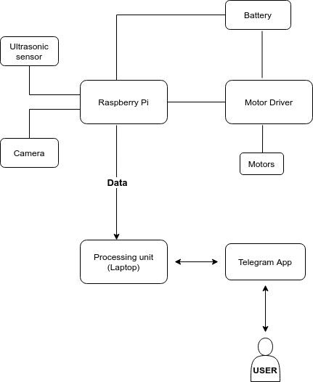
System Architecture

Slide 16
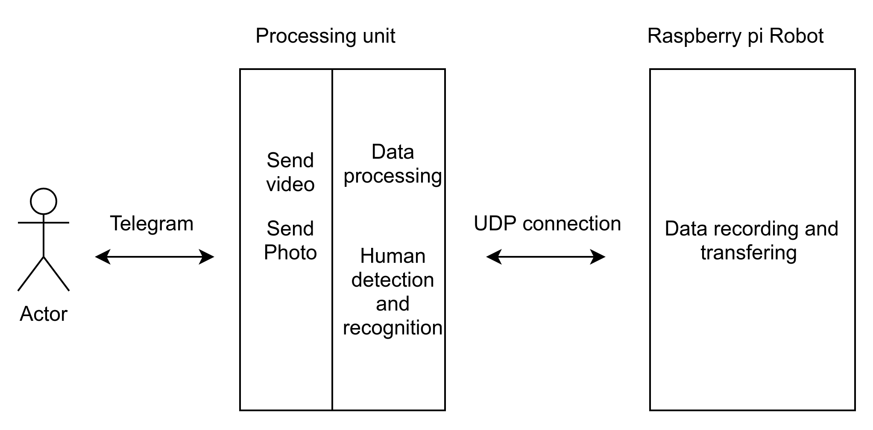
Component Diagram

Slide 17
Requirements
Functional Requirements:
Identification of person, alerting the owner.
Communication between user and the robot.
Non-Functional Requirements:
Performance: The performance of the system depends highly on accuracy of the machine learning algorithms.
Security: Only the authenticated user should be able to send commands to the system. The images/videos captured from the system should be sent to the appropriate user only.

Slide 18
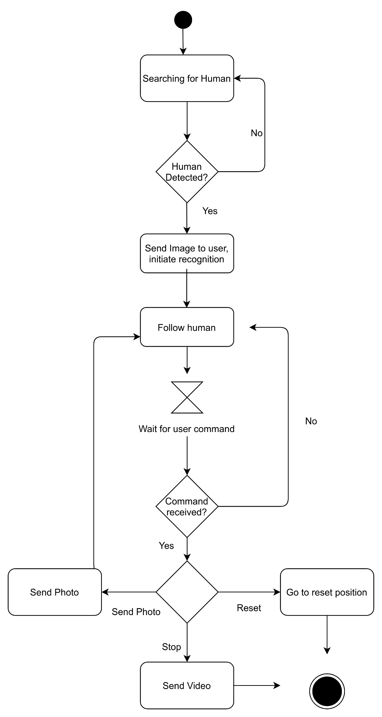
Activity Diagram

Slide 19
Methodology
How it’s going to work:
Communication between raspberry-pi and the processing unit(Laptop) through UDP connection.
Communication between the processing unit(Laptop) and the user over Telegram App.
User gives commands to raspberry pi through processing unit.

Slide 20
Single Shot Detection Algorithm
Single Shot detector takes only one shot to detect multiple objects present in an image using multibox. It is significantly faster in speed and high-accuracy object detection algorithm.
SSD divides the image using a grid and have each grid cell be responsible for detecting objects in that region of the image. Detection objects simply means predicting the class and location of an object within that region.

Slide 21
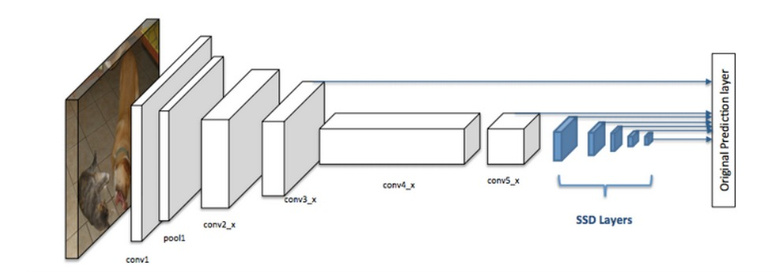
Fig: Single Shot Detection Algorithm

Slide 22
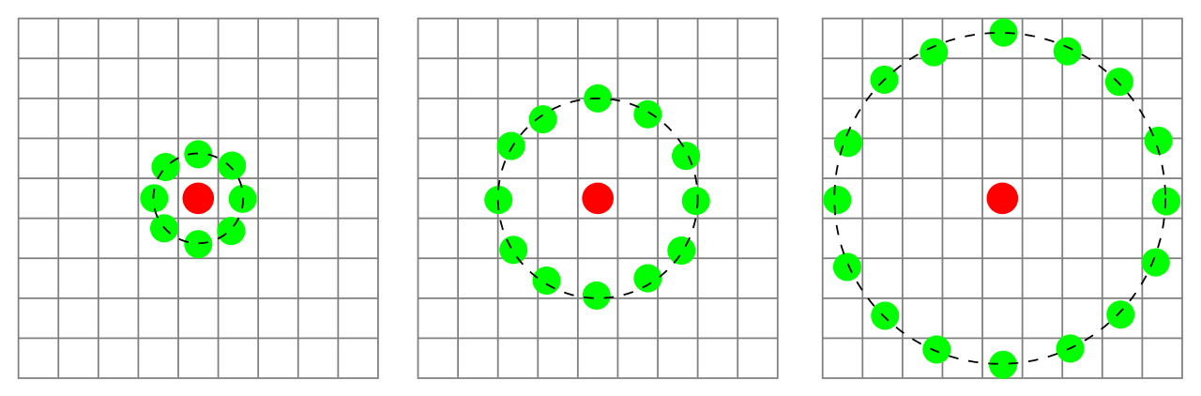
Local Binary Pattern Histogram
Local Binary Pattern Histogram(LBPH) is a simple yet very efficient texture operator which labels the pixels of an image by thresholding the neighborhood of each pixel and considers the result as a binary number.
The algorithm uses a concept of a sliding window, based on the parameters radius and neighbors.
Figure: Three neighborhood examples used to define a texture and calculate a local binary pattern (LBP).

Slide 23
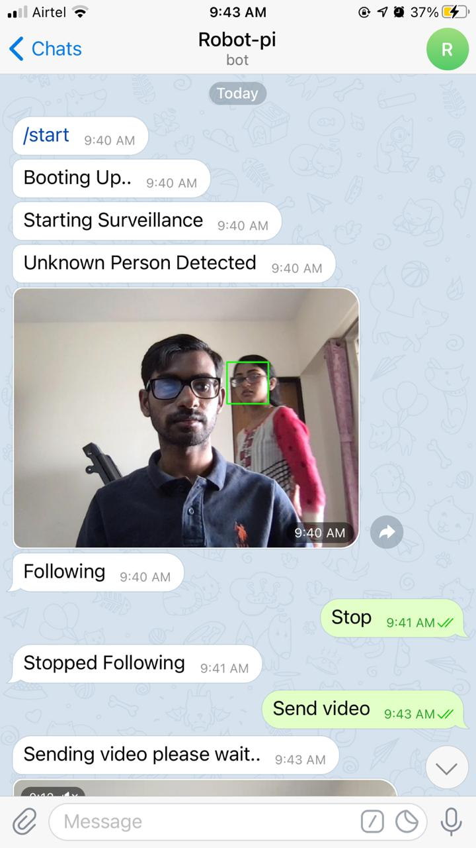
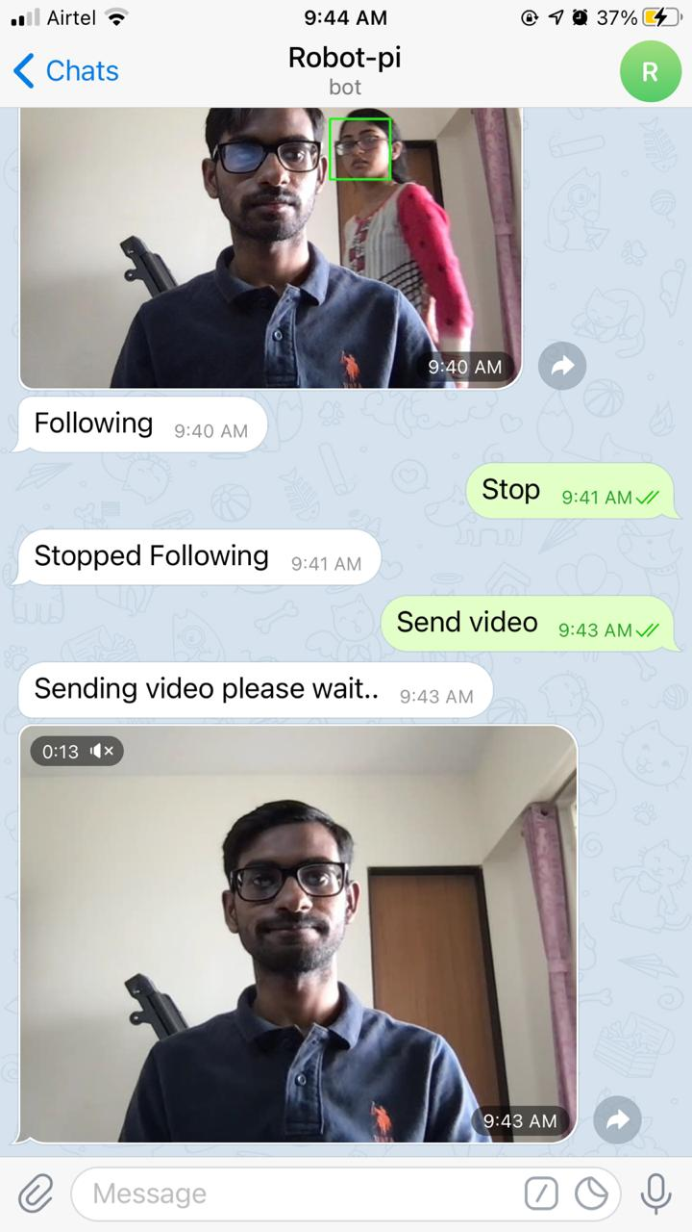
Frontend Images

Slide 24
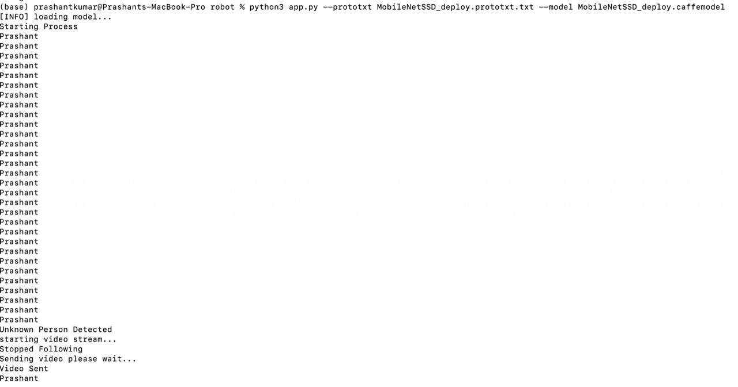
Backend Image

Slide 25
Conclusion
Even though the development cost is kept as low as possible, the system is capable of navigating while engaged in surveillance, recognizing intruders via facial recognition.

